Slide 1
The possibilities of congestion control mechanisms in FAN networks
Dominik Najder
Jakub Palider

Slide 2
Presentation plan
Current network quality requirements
What is congestion?
What are the current QoS solutions?
Int- and DiffServ
Features of FAN
How does congestion control is implemented in DiffServ?
Traffic conditioning mechanisms
Is it possible to implement DiffServ congestion solutions into FAN?
What DiffServ congestion control ideas may be used in FAN?
Measurement Based Admission Control (MBAC)
Cross-protect in FAN router
Future

Slide 3
Current network quality requirements
Nowadays networks are expected to support a variety of services beyond the best-effort service available today
New applications already rely on the network ability to guarantee such services
High speed packet-switched networks
Applications requiring
bandwidth
Applications requiring
low latency
P2P Networks, Large Databases,
Large multimedia files,
XBOX Live
VoIP, tele-conferencing,
UMA, on-line gaming,
distance learning
Notes:
Near-future high-speed packet switched networks are expected to support large variety of services far beyond the best-effort service available today. New applications such as VoIP, distance learning or PeerToPeer rely on ability of the network to guarantee different types of services. For example on-line gaming would expect the network to ensure that each flow of traffic receives its fair share of the bandwidth and is able to provide guarantee that delay between players will not exceed earlier specified limit. On the other hand there are services that don’t require any special latency limits – however they require as much bandwidth as possible. The good example would be Xbox Live from Microsoft – where one can download game content and music/movies directly to one’s console.
What is the operation of such services in best-effort Internet?
Low quality VoIP calls, often impossible to easily communicate, or problems such as the one from US Xbox live users – that needed to wait at least 10 hours to see the movie they decided to buy.
The future applications require working Quality of Service solution to efficiently manage and divide shared resources among competing users. There is no other way to solve the problem of congestion.

Slide 4
What is congestion?
Simple definition: congestion occurs when traffic coming into one link exceeds its capacity e.g. motorway
Main reason: lack of bandwidth
  Demand bigger than capacity
  Suddenly changing demands
  Network failures
  Changes in routing
Notes:
Congestion occurs when traffic coming into one link exceeds its capacity. If one has problems with understanding congestion – one should drive the main city streets at rush hours.
Congestion is a result of everlasting problem – demand is greater than supply – in telecommunications the requested resource is bandwidth. Nowadays core networks still have very high redundancy of capacity – the problem typically occurs where multiple links feed into a single link, such as internal LANs are connected to WAN links.
The reason for congestion may also be suddenly changing demands – as an example we could take VoIP – new technologies require new traffic quality – and some of the networks were not designed to be reconfigurable or were limited to one type of service – e.g. HTTP.
Although core networks still have redundancy, in case of failures or relevant changes in routing they may have congestion problems – backbone links serve in such a situation more traffic than they were supposed to – sometimes the amount of information sent is few times bigger.

Slide 5
What are the current QoS solutions?
Already Implemented:
Integrated Services – IntServ, the first model defining whole concept of QoS
Differentiated Services – DiffServ – later conception, opposite (in majority) to IntServ
New Idea:
Flow Aware Networking
Notes:
There are two QoS solutions already created and implemented inside hardware. Both are the result of IETF works, however there are few years of difference between their creation date.
IntServ was the first concept to enhance the model of Internet with management and division of available bandwidth in data links, based on flows classification and explicit resources reservation. However it was immature, and it showed off that it is rather impossible to implement in whole internet.
The second concept was DiffServ, opposite (as mentioned before) to IntServ. It managed to overcome its predecessor problems in scalability at the expense of some restrictions in its features. DiffServ presented the idea of no resources reservation and QoS classification based on aggregates. Although it is a mature model, due to some disadvantages it is also not commonly used.
FAN is the next generation model, whose main attitude is to take the best features from both models and avoid their main disadvantages. Its idea comes from France Telecom R&D team.
So what are the main differences between IntServ and DiffServ – you will see on next slides.

Slide 6
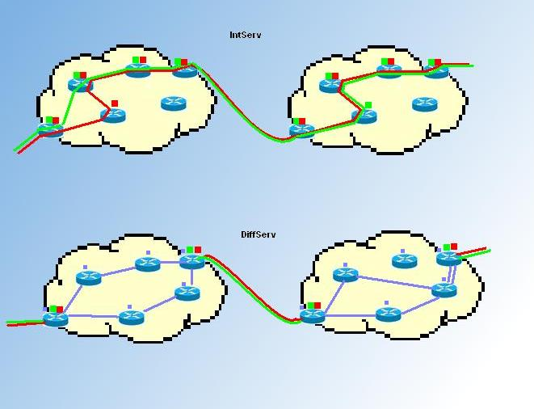
Int- and DiffServ
Notes:
This figure illustrates the different approaches in achieving guarantee of QoS in networks. IntServ solution is in the upper part while DiffServ in the lower one. Yellow areas present distinct core networks.
IntServ needs to trace each flow on each router that is passed by the flow (this is forced by RSVP protocol signalling) in order to provide expected service.
DiffServ does not have such requirements, excluding core networks, however. IntServ is called per flow method, whereas DiffServ per node. Flows In DiffServ are tracked only by border routers while performing inter-domain agreements. That is marked with red and green dots in the picture (for both IntServ and DiffServ).
Internal behaviour of DiffServ in domains is represented by violet dots. In the simplest example both flows arriving to the domain (red and green) fit the same earlier defined traffic class – internal routers need to know only the class type of a given flow, to process packets. So every router participates in providing a packet its class of Service – according to one of the „behaviors” – e.g. Expedited forwarding (Very low delay, low jitter and assured bandwidth). This is called as Per Hop Behaviour (PHB).

Slide 7
Main differences between IntServ and DiffServ
Parameter
IntServ
DiffServ
Coordination for service differentation
End to end
Per hop
Classification of traffic
Limited by number of flows
Limited by number of classes of service
Network accounting
Based on flow characteristics and QoS requirement
Based on class usage
Network management
Similar to network switching (e.g. phone calls)
Similar to IP networks
Inter domain deployment
Multilateral agreements
Bilateral agreements
Quality guarantees
Per flow - bandwidth and delay guarantee
Cannot provide low delay and high bandwith guarantee simultaneously
Scalability
Information held in each network node – not scalable
Scalable and robust
Notes:
The slide presents main differences between IntServ and DiffServ.
In IntServ the resources are overtly reserved in each router of the network path before beginning the transmission – traffic requirements have to be explicitly specified. The classification is based on flows – each of them has its bandwidth and delay guarantee – what is especially important in VBR, CBR traffic types – e.g. VoD. This type of QoS is good for short-lived reservation, when high resource utilization is required. However it is not scalable – each network node needs to hold an information about network state.
DiffServ shows totally opposite approach - it operates on the principal of traffic classification, where each packet is qualified into one of the classes; rather than differentiating network traffic based on the requirements of an individual flow
(IntServ). Each traffic class is managed in a different way – depending on its requirements – e.g. low latency or assured bandwidth – however you cannot assign packet to 2 traffic classes. There is no information about individual flow in each network node – the design is more scalable and robust. Admission control is performed only DiffServ domain endpoints.

Slide 8
Features of FAN
No reservation
Classification based on flows
2 flow classes - stream (audio, video, real-time) and elastic (digital documents)
Idea of cross-protect router – accurate relation between admission control and scheduling
“Good enough” performance
Cost effectiveness and accountability $$$
Notes:
The main features of FAN show us that it really takes the best from both previous architectures. There is no resources reservation before start of transmission – all the flows are identified on the fly – there is no additional signaling.
Traffic classification is based on flows – there are only 2 types of them:
a.) stream – assigned to all real-time audio, video, playback transmission, and all the traffic that will require small delays and low packet loss.
b.) elastic – assigned to Web pages, mail, files, stored video – these flows will share the rest available bandwidth (fairly and efficiently)
“Good enough” performance means that the performance guarantees of FAN are probabilistic. A streaming flow of low peak rate is assured low packet loss and delay. Loss probability and delay, as well as the maximum peak rate, may be controlled by appropriately defining admission control criteria.
The idea of cross-protect is the main notion of FAN – it applies Measurement Based Admission Control – the control and identification of link usage and saturation is done dynamically by scheduler and it is forwarded to admission control block, so it can decide if the new incoming packets should be serviced or dropped off.
The last feature is about money - FAN would enable greater cost effectiveness by allowing more efficient capacity planning. This derives from the insurance provided by admission control: quality and efficiency are assured even in the event of overload.

Slide 9
FAN – pros and cons…
Advantages
Disadvantages
Good scalability
Ease of admission control in each network node (MBAC)
Only small amounts of data stored in network node memory
No strict guarantees of network performance
Not yet implemented
Notes:
The features presented on the previous slide result in the following advantages and disadvantages. The main amenity of FAN is scalability – up till now no solution was really implemented in Internet to be the standard of QoS. With FAN it is more possible, while the information held in network nodes is very small, and design not complex, what should result in lower hardware costs and easier implementation.
The second advantage is MBAC, mentioned in the previous slide – this solution will allow router to properly estimate bandwidth requirements and identify current link situation. Additionally there is no need to transfer and hold additional information about link SLA in each node – and this is the 3rd advantage – amount of data stored is much smaller then in previous design. This results in simpler hardware design.
The main disadvantage is a lack of any strict network performance guarantee (as e.g. in IntServ). It is possible that in some rare situations the link capacity guarantee won’t be fulfilled – however it may be adjusted by specifying proper parameters.
The second disadvantage is quite simple – there is no ready implementation of hardware router – the only results we have are from simulations and calculations, the reality may be different.

Slide 10
How does congestion control is implemented in DiffServ?
QoS Mechanisms
Packet level
Admission level
classifier
AC (admission control)
traffic conditioners
scheduler
Network traffic entering a DiffServ domain is subjected to classification and conditioning
AC realized only in edge routers, controlled by Bandwidth Broker
PHB define packet forwarding properties inside domain
Notes:
Congestion control is realized in DiffServ by standard QoS mechanisms. They can be divided into 2 groups:
a.) packet level control
b.) admission level control
In DiffServ as we mentioned before – large part of QoS mechanisms is used only in edge routers. First example is admission control, controlled by Bandwidth Broker. It is an DiffServ domain agent that has some knowledge of an organization's priorities and policies and allocates bandwidth with respect to those policies. The second type of mechanisms located only in edge routers is classification and traffic conditioning.
Classification mechanisms consist of aggregates, which perform filtering of incoming packets – e.g. they assign packets to predefined network services, according to selected IP header fields. Applicable filtering elements divide packets into matching and non-matching to accepted filter model. According to performed selection packets are assigned proper class of traffic. As we mentioned before all DiffServ aware routers implement Per-Hop Behaviors (PHBs), which define the packet forwarding properties associated with this class of the traffic.

Slide 11
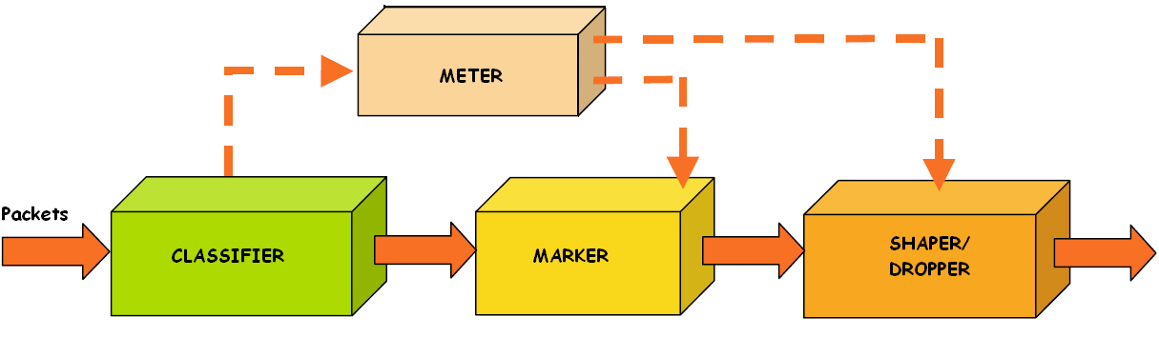
Traffic conditioning mechanisms
Traffic conditioning is performed only in edge routers – the assumption is that inside DiffServ domain the bandwidth is even overestimated
Notes:
Traffic conditioning mechanisms perform 4 types of operation:
a.) metering
b.) marking
c.) shaping
d.) dropping
The aim of the monitoring is to check if selected packet flow is compliant or non-complaint with assumed profile.
Packet marking may be performed on packet coming directly from classifier block, or on a packet coming from meter block.
The aim of this step is to set proper value of header fields, which are designed to hold that information. In case of DiffServ, marking means setting correctly DSCP fields in packet header. This allows packets to be served in proper way on every next level of service.
The last traffic conditioning block is shaper/dropper – its mechanisms allow to remove packets from network, which are not complaint with their declared traffic profile or which removal may influence and change traffic generated by packets source. In both cases the shaping/dropping process should support requirements specified for selected service in QoS.
The next step for all packets are scheduling mechanisms.

Slide 12
Scheduling mechanisms
Assures differential quality in routing packets assigned to different flows
Different packet types Different quality of service
Many algorithms (FCFS, PS, FQ etc.)
Quality
Selecting which packets should be sent first
Selecting which packets may be dropped
Notes:
In scheduling block packets are assigned to different queues, on their QoS class basis. Different packet types are assigned different quality, by simple selecting which packets will be sent first (packets moved to queue that has the highest priority) or selecting which packets may be dropped as first (which packets will be moved to queue with the lowest priority). Thus, we can specify 2 types of parameters for sending packets – packet delay, and packet loss ratio.
The important thing is the fact that scheduling is performed in each DiffServ router.
There are many different algorithms supporting queue managements - e.g. FCFS (First Come First Served – the other name for that algorithm is just FIFO), PS (priority scheduling), FQ (fair queuing), DRR (deficit round robin). Some of them, or their modifications will be presented on next slides.
Now its time to leave DiffServ and move to FAN.

Slide 13
Is it possible to implement DiffServ congestion solutions into FAN?
Differences in congestion control ideas:
DiffServ
FAN
AC, classifier, traffic conditioner, scheduler blocks
Only AC and scheduler blocks – cross protect router
Admission control performed only in edge routers
Admission control performed in every router
No information about flows inside router memory – QoS based on information about agregates
Router holds only flow list, without declaration info for traffic class
Domain agent Bandwidth Broker
No central agents
No info about network state hold in routers
Information based on measurements held in every router
Notes:
Although FAN derives advantage from many DiffServ solutions, both architectures are very different.
At first let’s look at the structure of basic router – there are no blocks like classifier or traffic conditioner in FAN, both solutions have Admission Control and scheduler blocks – FAN is much simpler.
Additionally, Admission Control block in DiffServ is only used in edge routers. The idea of cross-protect router in FAN results in Admission Control performed in each router, not only in edge ones.
The next main difference is a results of basic QoS attitude of both solutions – as mentioned before DiffServ is based on aggregates, while FAN assigns packets to flows. Because of that fact different type of information is held in both solutions. DiffServ needs to store info about the way to recognize and assign packets to different traffic classes, whereas FAN needs to hold the list of flows actually served.
When comparing both QoS mechanisms we cannot forget about the Bandwitdth Broker, which is an idea unique for DiffServ. There is not FAN domain centralized agent responsible for admission control process and negotiations with other domains. It is also very important while it holds the info about network state – the routers are not aware of traffic situation in whole domain. In FAN situation is opposite – no central agent, makes each router gather information about network, based on constant measurements.

Slide 14
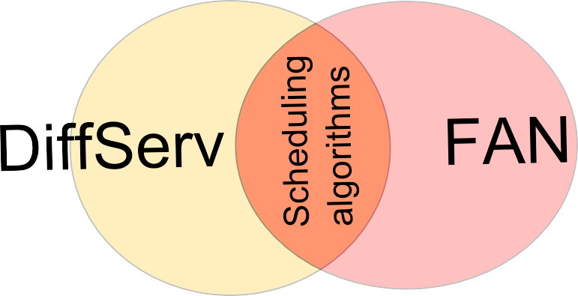
What DiffServ congestion control ideas may be used in FAN?
The only common mechanisms are admission control and scheduling, but the admission control is realized in different way
Scheduling algorithms may be implemented in FAN
There are many elementary conceptions common to both architectures – but these are mostly basics of QoS idea
Notes:
On the basis of information from previous slide we can conclude that the only common space for FAN and DiffServ is scheduler block. The admission control is implemented in both architectures but in DiffServ it is built in a central way (Bandwidth Broker with edge routers), and in FAN it is distributed among every router. The second difference is that one architecture uses aggregates and the second one flows as a method of QoS traffic classification. The differences are too major to search for simple solution transition from one to another.
The second block implemented in both designs is scheduler. Of course we cannot copy entire block – the simplest reason is different traffic classification – but we can think about transition of queue management and scheduling algorithms. In the following slides we will describe two scheduling algorithms, that may be implemented in FAN. First one is Priority Fair Queuing and the second one is Pre-Order Deficit Round Robin. But first we will concentrate on the idea MBAC and cross-protect router.
Of course we cannot forget that there are many others, minor details that are (or may be, as FAN concept is not yet complete) common to both solutions. However we will not cover such details in this presentation.

Slide 15
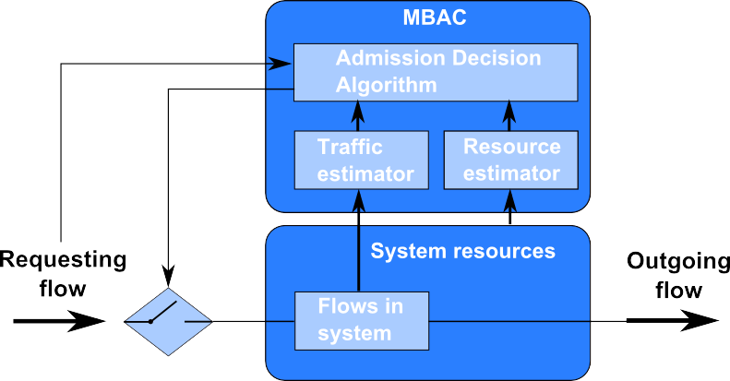
Measurement Based Admission Control (MBAC)
Notes:
In FAN networks, Admission Control in each node secures the proper conditions for every already registered flow in case of congestion. All the decisions about new incoming flows are made in this block – whether to service or reject requesting flow. Every flow, serviced currently by router is registered on special list – called PFL (Protected Flow List). If requesting flow is already on the list, all of its packets are serviced instantly, if not the admission decision algorithm is performed. If the link is currently under congestion and transfer of new incoming packets is impossible, then the flow is rejected. If the link is free (have enough bandwidth to service new flow), then it is accepted and added to PFL. This is also the way user gets information about congestion in network – in such a case his request for new flow is rejected.
But what about small amounts of data held in each router that we have talked about before? Is the PFL not getting bigger and bigger with each incoming flow? To prevent that situation, all the flows are monitored. If there is no packet with id from given flow for a while, then it is removed from the list.
There is still one more question about the way the router monitors links saturation. It is done actually by Scheduler block.

Slide 16
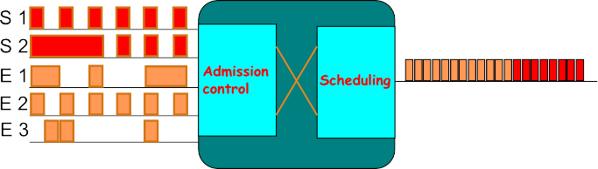
Cross-protect in FAN router
Incoming packets
Outgoing packets
Notes:
The implementation of both Admission Control and Scheduling mechanisms assures differentiation of quality for 2 types of traffic that are described in FAN. Measurements of link utilization are performed in a constant way in Scheduler part. All the decisions about accepting new flow are made on the basis of this link utilization and bandwidth per one flow in current PFL (which is also measured in scheduling block).
This way both mechanisms are strictly dependant – Admission Control block uses data from Scheduler to monitor the probability of packet loss, possible packet delay, and also the maximum bandwidth for the flow to be treated as stream. Scheduling provides also the AC block with the measurements of fair bandwidth – this is connected with proposed by the authors of FAN scheduling algorithm, called Priority Fair Queueing, which differentiates flows by their bandwidth – if it is bigger or lower than fair value.
This algorithm will be described and explained in the following slides.

Slide 17
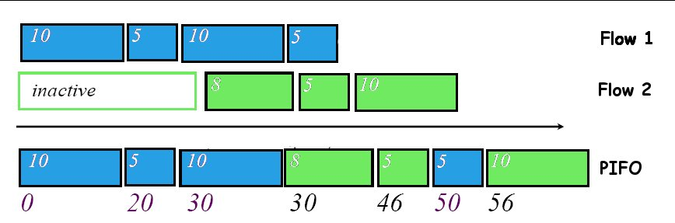
Priority Fair Queuing
Modified version of Start-time Fair Queuing
Push-In First-Out queue, each element has timestamp
Active Flow list
Virtual Time counter
Notes:
The PFQ algorithm is a modified version of Start-time Fair Queuing. Thus to explain PFQ we will start with SFQ.
A SFQ scheduler maintains the following data:
a.) PIFO queue –the list of packets to send stored in decreasing order of timestamps. Each packet upon arrival is assigned a timestamp, which is some kind of “start tag” based on SFQ algorithm. PIFO queue is the same as FIFO, the difference is that new elements may be put inside the list, not only at its end as in FIFO.
b.) Active Flow list (PFL) – the list of registered flows already in service. Each flow has its “flow timestamp” which we can consider as a “finish tag” of the packet currently serviced.
c.) Virtual Time – a counter which we can refer as current system time. The value of this counter is a timestamp (“start tag”) of the packet currently served
Let’s move to the example. We have to flows. The rectangles are packets. The numbers inside packets are they lengths. The arrow shows the time change, on the bottom of the picture one may see time points of simulation. The capacity of link is 0.5 packet/time unit. First blue packet will be sent in 20 time units, so the second blue packet “start tag” is 20 – because it’s the “finish tag” of last packet in blue flow. It will be sent in 10 units time so the “start tag” of third blue packet is 30 (20 + 10). The third packet will be sent in 20 time units (10/0.5). Thus, “start tag” of last blue packet is 50 (30 + 20).
But what about 2nd flow. As we said before Virtual Clock is equal to “start tag” of packet currently serviced. So when first blue packet was sent VT value is 0, when 2nd blue packet was sent the VT was 20, and so on 3rd – VC is 30, 4th – 50. When first packet of new flow is registered on the router, its timestamp (“start tag”) is equal to current VT value, so in our example it would be 30. Next packets are given “start tags” the same way as in case of 1st flow – based on “finish tags” of previous packets in their flow.

Slide 18
SFQ algorithm
Packet arrival:
on arrival of l-byte packet p of flow f:
if f is a registered in ActiveList do
p.TimeStamp = f.FinishTag
f.FinishTag += l
else
add f to ActiveList
p.TimeStamp = VirtualTime
f.FinishTag = VirtualTime + l
Packet departure:
transmit packets in increasing TimeStamp order
at the start of transmission of packet p:
VirtualTime = p.TimeStamp
for all flows f registered in ActiveList
if (f.FinishTag < VirtualTime)
remove f
if no packets in scheduler VirtualTime = 0
Notes:
This is the algorithm of SFQ divided into packet arrival and packet departure. The fact we need to remember is that list of Active Flows is finite. We assume that packets of new flows that cannot be registered are put into PIFO queue with timestamp equal to Virtual Time. This is the required action, because if the ActiveList is not finite, it will be vulnerable to overflow.
As for packet departure algorithm – we need to remember about the following facts:
packets are sent in increasing timestamp order
Virtual Time is always set to “start tag” (timestamp) of currently serviced packet
Flows which “finish tag” (the “finish tag” of last registered packet of that flow) is lower than Virtual Time must be removed. It means that flows which all packets were already sent are removed from ActiveList
If all packets were sent, and there is no new one, Virtual Time is set to 0.

Slide 19
PFQ algorithm
Packet arrival:
if PIFO congested, reject packet p at head of longest backlog
if f is registered in flow list F
if bytes >= MTU
p.TimeStamp = f.FinishTag
else begin
p.TimeStamp = virtual time
put behind P, update P
f.FinishTag += l
else
p.TimeStamp = VirtualTime
put behind P, update P
if flow list is not saturated
add flow
f.FinishTag = virtual time + l
Main disadvantage:
SCALABILTY
Per packet computational complexity is O (logQ), where:
Q – number of flows server by the router
Notes:
This is the PFQ simplified algorithm. The difference comparing to SFQ is a pointer P identifying the last of the priority packets at the head of the PIFO queue. This pointer is necessary to realize priority queuing, distinguishing between packets of backlogged and non-backlogged flows having the same timestamp. This is realized in lines 7 and 11.
The priority packets are recognized if the cumulative volume of transmitted bytes is less than the maximum packet size, MTU (step 3). However, If the flow is not active, the packet is given priority. It acquires virtual time and is inserted in the PIFO at the position indicated by P (same as for registered priority packets).
An internal counter keeps track of the total number of priority packets’ bytes for congestion measurement.
There is no sense in presenting the packet departure algorithm, while it is quite similar to SFQ.
So if PFQ a perfect algorithm? No it is not. Its main disadvantage is scalability – the computational complexity is logarithmic, what will be a main problem considering serving great number of flows. That is why the better concept may be to use PDRR, a modified version of Deficit Round Robin.

Slide 20
Priority Deficit Round Robin
Based on standard DRR
Per flow f state:
  f.Identier - the flow identifier (possibly a hash of the relevant header fields)
  f.Queue - current length in bytes of flow f queue
  f.Quantum - value of flow f quantum ( >= MTU bytes)
  f.Deficit - current flow deficit
  f.FIFO - addresses of head and tail packets of a linked list forming the flow f FIFO
  f.Next - the next flow in the DRR schedule following flow f
Notes:
PDRR, is a fair queuing algorithm that inherits the O(1) complexity and fairness properties of DRR while improving latency by the use of a priority queue for low rate flows.
Flows that need to be accounted for by the DRR scheduler are logged in a table called Active Flow List AFL (Protected Flow List PFL). Necessary per-flow state for a given flow f using DRR is:
Identifier – the unique flow ID
Queue – which is number of bytes of flow which need to be serviced
Quantum – this is kind of weight value assigned at the beginning to each flow
Deficit – current flow deficit calculated constantly on packet scheduling
FIFO – linked list of packets
Next – address of the next flow to be scheduled by scheduler
The simplified version of PDRR algorithm is presented on next slide.

Slide 21
Priority Deficit Round Robin simplified algorithm
Packet enqueue:
If no free buffers left then
dropPacket();
i = ExtractFlow(p);
If (i is not registered in AFL)
InsertActiveList(i);
i.DC = 0;
i.ByteCount = size(p);
Enqueue(PQ, p)
Else
i.ByteCount += size(p);
If (i.ByteCount <= i.Q) then
Enqueue(PQ, p);
Else
Enqueue(i.Queue, p);
Packet dequeue:
While (PQ not empty) do
p = Dequeue(PQ); i = ExtractFlow(p);
Send(p); i.DC -= Size(p);
If (AFL is not empty) then
Get head of AFL - flow i;
i.DC += i.Q;
While ((i.DC >= 0) and (Queue i not empty)) do
PacketSize = Size (Head(i.Queue));
If (PacketSize <= i.DC) then
Send(Dequeue(i.Queue));
i.DC -= PacketSize;
Else
break;
RemoveActiveList(i);
If (Queue i is not empty) then
InsertActiveList(i);
Notes:
If on the arrival of a packet p the buffer is full, a packet must be selected for dropping (1-2). If packet p does not belong to an active flow, the flow is added to the current end of the AFL cycle and the packet is inserted at the tail of PQ (4-8). i.ByteCount keeps track of the number of bytes already inserted in PQ for flow i. A packet arriving to an active flow is given priority if i.ByteCount(i) <= i.Q (11-12); otherwise it is placed at the end of the flow queue (14). These operations (and the removal of inactive flows from AFL) ensure that packets of flows emitting less than one quantum per round realize have packet latency.
The dequeue operation extracts the packet at the head of PQ whenever it is not empty (1-3). When a packet is sent from PQ, the deficit counter of its flow is decreased by the packet size (3). This prevents more than one quantum being served during the same round. When PQ is empty and AFL contains at least one flow (4-5), the flow at the current head of the AFL cycle is selected for service and its deficit counter is incremented by one quantum (6). The last instructions (7-13) allow the flow to emit up to DCi bytes. The flow is removed from the schedule if it empties (14). Note that this will happen if the flow emitted less than its quantum in the current round or, in other words, if its rate is smaller than the current fair rate.

Slide 22
PFQ vs PDRR
Which solution is better?
PFQ:
-simple
-but higher computational complexity O(logQ) – not well scalable
PDRR:
-more complex, bigger amount of data to be held inside router
-computation complexity O(1) – very scalable, main FAN feature over DiffServ
Notes:
There is no simple answer about the winner of scheduling algorithm match, both solutions have pros and cons. PFQ is simple, but computational effort is to big – there is a risk of no scalability – which is very important for FAN. PDRR is more complex in implementation, however computational effort is very attractive, and allows the solution to be scalable – what is the main feature of FAN, that should encourage IT specialists to move away from DiffServ.
Of course we cannot forget that there are many other scheduling algorithms, that also could be well implemented in FAN (after small modifications).
The concept of this QoS solution is not yet complete, so there it is still possible to find something new.

Slide 23
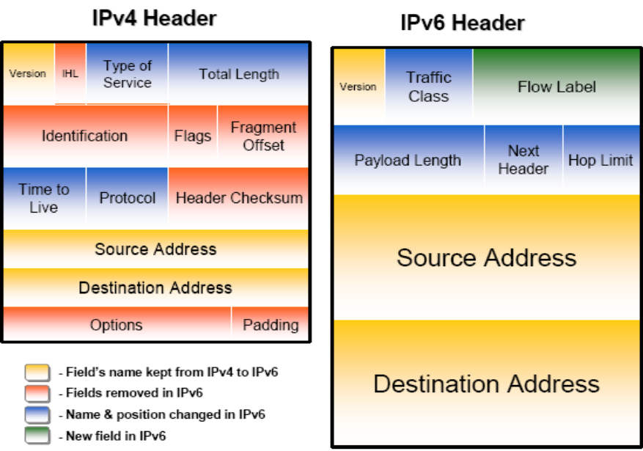
What is the future?
Redesign of IPv6 packet
Minimized header overhead and reduced header process for the majority of packets
Less essential fields removed or moved to extension headers
Traffic class in IPv6= TOS in IPv4
New Flow Label
Notes:
The IPv6 is the internet future. We often hear about solutions that are ready for IPv6, however the overall speed of transition from IPv4 to IPv6 Is rather slow. Despite that fact, we may be sure that this is the future solution. And what are the differences?
The IPv6 packet was redesigned, to better address the need of next generation internet. In the picture we can see major changes – minimized header overhead, and the removal of less important fields. TOS from IPv4 was changed into Traffic Class field, which holds the same function, but is twice bigger (8bits).
A very important change was made by introducing Flow Label, a 20-bit field defining the packets of the flow. It is selected by the source and never modified in the network. What is more important – is the fact that flow label is defined before address, in case a flow routing is used (in this case the route is calculated only once). This is also a very important field for us, it will strongly support idea of Flow Aware Networking. It will also allow routers to improve speed, and reduce queuing delays. There is also a question of implementation of QoS that will be implemented in future internet.

Slide 24
Which QoS solution is better?
FAN takes the best of DiffServ and IntServ
It’s idea is closer to current traffic characteristics
FAN is more scalable and flexible
FAN is not yet implemented – improvements are still possible
However FAN is not yet implemented – and may never be…
Notes:
There is no doubts when it comes to IntServ and DiffServ comparison. IntServ architecture is too inflexible, and not scalable, it also requires a strict SLA and resources reservation. DiffServ doesn’t give traffic service level guarantees as IntServ but is much more adaptable.
But what about DiffServ and FAN? FAN idea is closer to traffic characteristics of current internet. There is a great need for good quality differentiation nowadays – especially with new services like e.g. VoIP – and FAN better supports the idea of stream flows.
FAN is and will be more scalable – with the idea of flow networking presented in IPv6 – FAN will have an opportunity to show its simplicity and performance.
The next fact is that FAN is not yet implemented – it is improved all the time – and still may be changed to better address the needs and characteristics of future Internet – there are no disadvantages that may not be overcame.
However the same fact is also a big disadvantage of FAN – there were many great ideas in the past, that were never implemented. Cisco for example, strongly supports the DiffServ solution, and may not be eager to change its plans to support new QoS ideas. But FAN also has a good financial background - its idea comes from France Telecom R&D team.
The only definite future fact is that QoS solutions will be dramatically improved in upcoming years.

